Slide 1
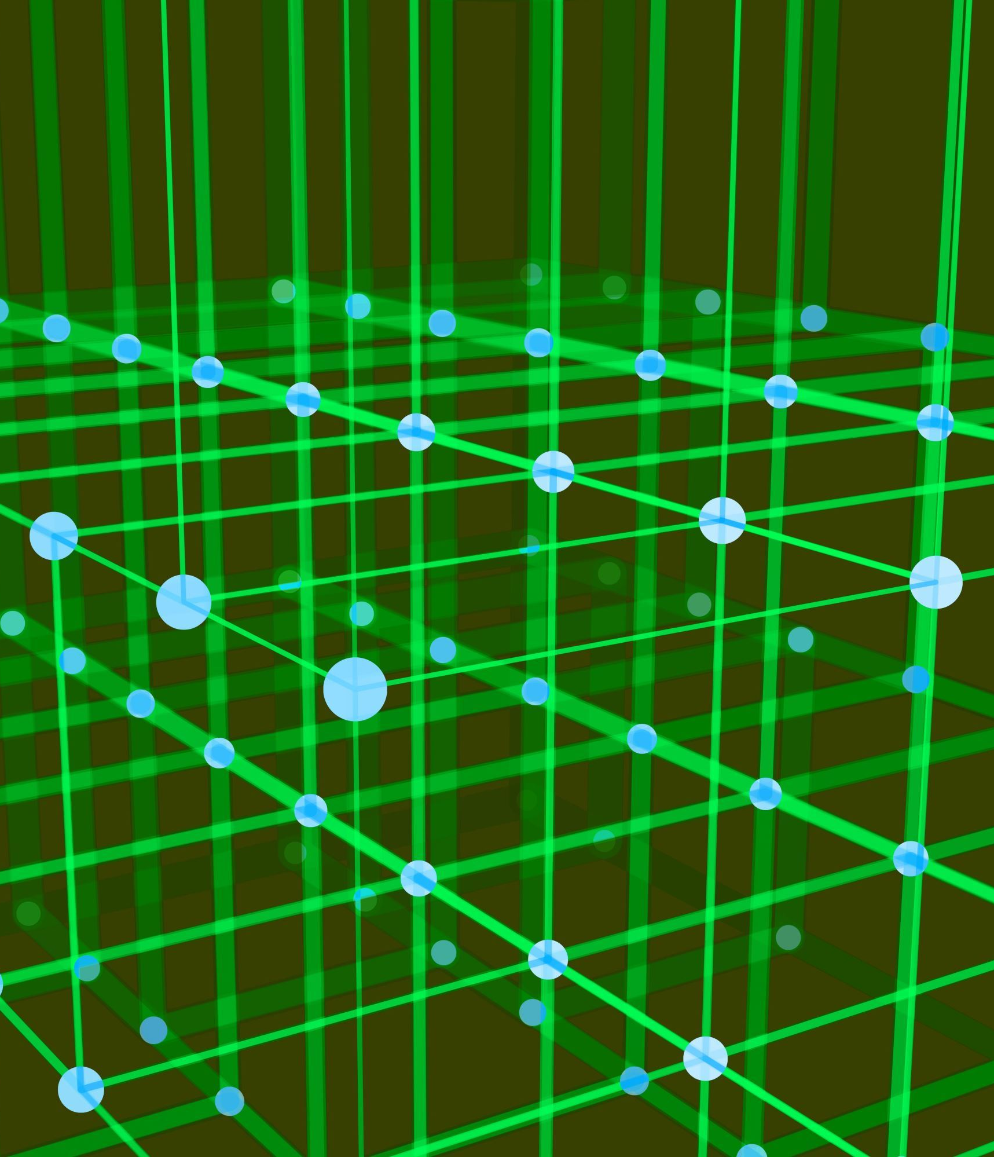
Certified Edge Unlearning for Graph Neural Networks
The paper titled "Certified Edge Unlearning for Graph Neural Networks" by Kun Wu, Jie Shen, Yue Ning, Ting Wang, and Wendy Hui Wang delves into a complex and critical problem in machine learning and data privacy. This technical review aims to provide an in-depth analysis of the paper's contributions, methodology, and implications within a scientific context.
Presented by
Shubhang Kaushik
Sourav Panda
Srivatsa Bhamidipati

Slide 2
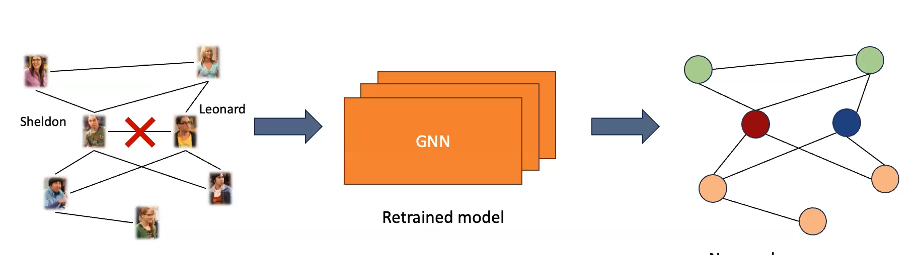
Introduction and Context
The paper begins by addressing the contemporary relevance of data privacy regulations, such as GDPR and CCPA, and the necessity for the "right to be forgotten."
Concept of “machine unlearning” - Involves enabling machine learning models to forget specific data instances.
The paper focuses on edge unlearning in Graph Neural Networks (GNNs), which entails training a new GNN model as if certain specified edges never existed in the original training graph.
The authors aptly set the stage for the problem at hand, emphasizing the increasing need for responsible data handling in machine learning.

Slide 3
Edge Unlearning in Graph Neural Networks
The central focus of the paper is on "edge unlearning" in the context of Graph Neural Networks (GNNs).
In this paper, we study Graph Neural Networks (GNNs) as the target model and edge removal as the unlearning request.
Edge unlearning entails the removal of specific edges from a GNN model trained on a graph, without the computationally expensive process of retraining the entire model. This is particularly challenging due to the inherent correlations between edges in graph data.

Slide 4
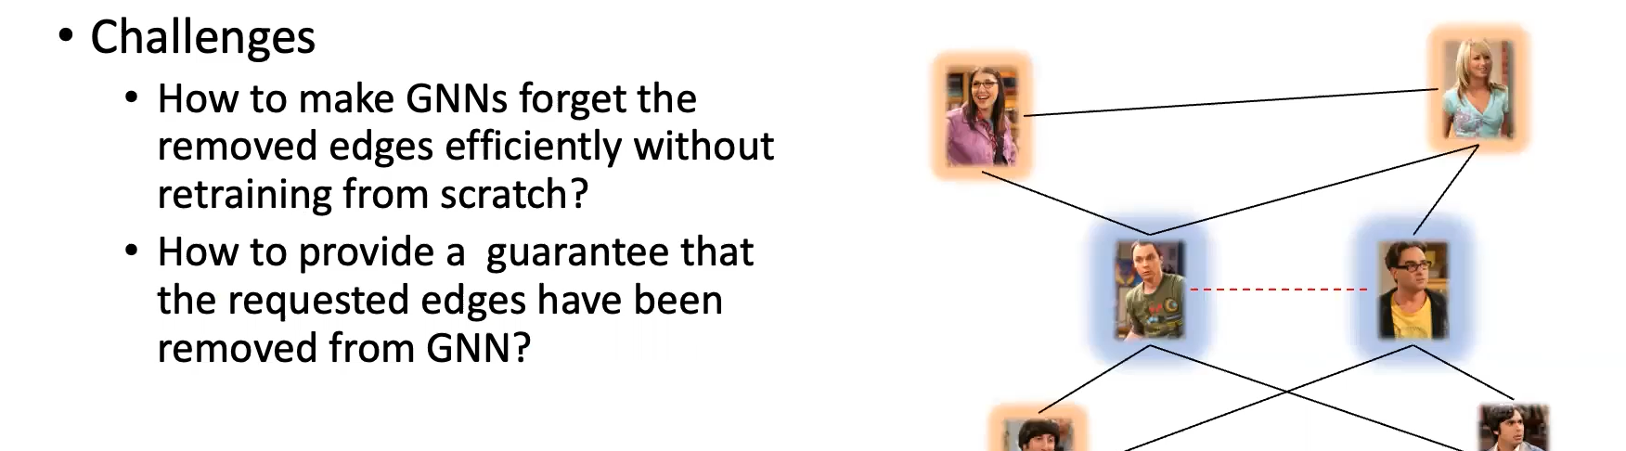
Edge Unlearning
Naively erasing edges from a GNN model by fully retraining can be excessively time-consuming, particularly for complex GNN models trained on large graphs.
As a result, recent efforts have focused on developing efficient methods for exact unlearning as well as approximate unlearning specifically tailored for GNNs.

Slide 5
Why Edge Unlearning in Graphs
Edges in graphs are correlated, unlike independent data samples.
Complex Data Dependency: Issues with complex edge correlations. Traditional methods are inadequate for addressing this challenge.
Solution - CEU framework addresses these challenges effectively by considering edge correlations and ensuring complete data removal.
Risk of incomplete removal due to unaccounted data dependencies. Consequence resulting in residual influence and privacy concerns.

Slide 6
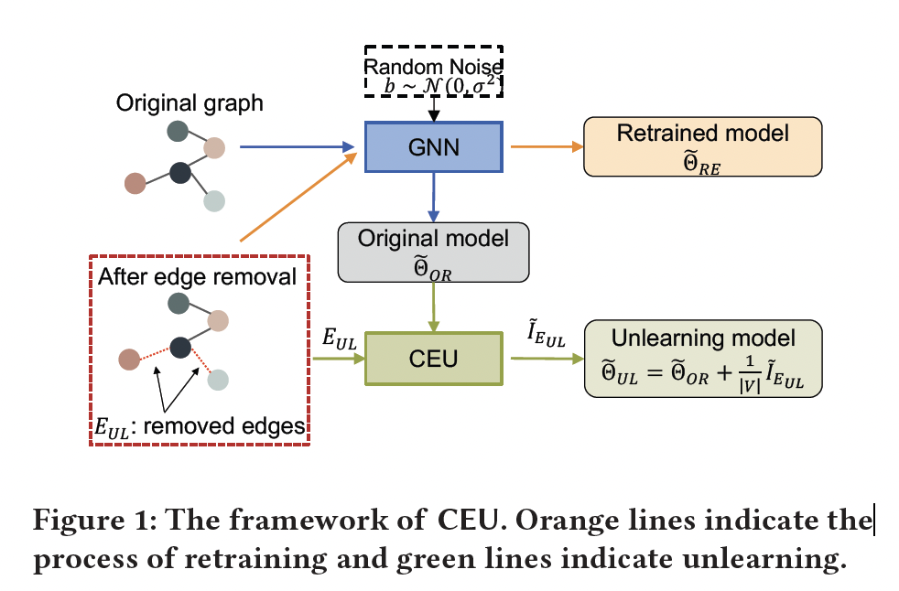
CEU Framework
Proposing CEU (Certified Edge Unlearning) as a solution to the complexities of edge unlearning in GNNs.
CEU is designed to efficiently update the parameters of a pre-trained GNN model in a single step, ensuring that the influence of removed edges is effectively eliminated.
This process is underpinned by theoretical guarantees.

Slide 7
Retraining vs. CEU
Retraining from Scratch: Conventional Approach - Removes specific edges by retraining the model from the beginning. Computationally Expensive - Requires significant computational resources. Time-Consuming - Involves a time-intensive process. High computational costs are incurred.
CEU Framework: Utilizes Certified Edge Unlearning. Efficiency - significantly reduces computational complexity. Speed - expedited unlearning process with a single-step update. Cost-Effective - economical solution for edge removal.
CEU offers a more efficient and cost-effective alternative to retraining from scratch.

Slide 8
Related Works
Machine Unlearning refers to a process that aims to remove the impact of a set of data samples in the training set from a trained model. From the certainty of unlearning, the existing machine unlearning methods can be divided into two categories: exact unlearning and approximate unlearning.
Exact Unlearning: Model retraining from scratch after data removal, computationally expensive.
Efficiency Efforts: SQ Learning [4], SISA Approach [2], Graph-specific extensions, e.g., GraphEraser [7] and GraphEditor [10].
Approximate Unlearning: Statistically removing data without distinguishability from exact deletion.
Certified Unlearning: Achieved through noise addition, e.g., on weights or loss function.
Existing Approaches: Chien et al. [9] (restricted to specific GNN structures), Cheng et al. [8] (lacks certified guarantee).
CEU Advantage: Significantly faster batch edge unlearning with certified guarantee compared to [9], extensible beyond specific GNN models

Slide 9
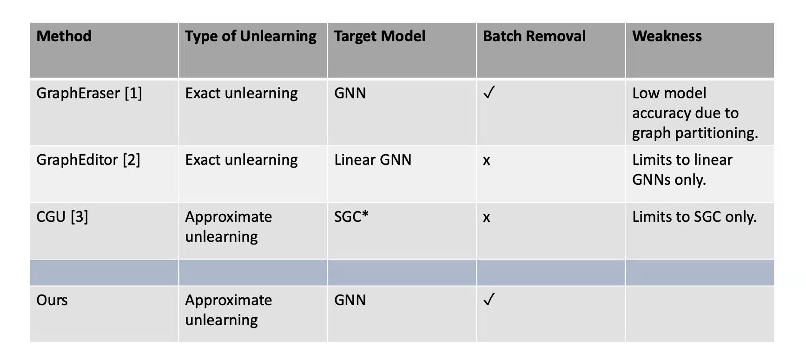
Insufficiency of Existing Approaches

Slide 10
Theoretical Analysis
Certified Guarantee in Unlearning - One of the significant strengths of the paper lies in its theoretical underpinnings.
Guarantee Requirement: Approximate unlearning necessitates confirmation of information removal.
Certified Removal Concept: Measures indistinguishability between retrained and unlearned models (𝜖, 𝛿)-differential privacy style.
(𝜖, 𝛿)-Approximate Unlearning: Ensures the unlearning model is approximately the same as the retrained model, within 𝜖 and 𝛿 bounds.
Edge Unlearning: Extends (𝜖, 𝛿)-approximate unlearning to batch edge removal for efficient unlearning.
Achieves multiple edge removal with (𝜖, 𝛿)-approximate guarantee and reduced computational complexity compared to retraining.
CEU provides a (𝜖, 𝛿)-approximation guarantee under the assumption of convexity on the loss function. Ensures the reliability and verifiability of CEU's unlearning process.

Slide 11
Contributions
Unlearning through influence analysis - an approach to address the unlearning problem by analyzing the influence of removed edges on the model. This involves finding a closed-form update for model parameters.
Certified unlearning - The paper delves into theoretical analysis and provides formal proofs that their Certified Edge Unlearning (CEU) framework can offer a rigorous (𝜖, 𝛿)-approximation guarantee. This guarantee is based on the assumption of a strongly convex loss function.
Empirical analysis - Effectiveness of CEU in practical settings. Presented with results for both linear and deep Graph Neural Networks (GNNs). In the case of linear GNNs, CEU achieves remarkable speedup compared to retraining from scratch, with a 16.2-fold improvement. It outperforms existing graph unlearning approaches, demonstrating a 63% improvement in model accuracy and a 3.7-fold speedup. For deep GNNs, CEU provides up to a 5-fold speedup while maintaining similar model accuracy.
This empirical evidence proves that CEU is not only theoretically sound but also highly efficient in real-world scenarios, making it a valuable tool for data privacy.

Slide 12

Methodology

Slide 13
Problem Formulation
For a set of graphs G with the parameter space represented as Θ, a learning algorithm A_{L} maps an instance 𝐺(𝑉, 𝐸) ∈ G to a parameter 𝜃 ∈ Θ. The parameters of A_{L} trained on 𝐺 is represented as 𝜃_{OR} and E_{UL} denotes the batch of edges that are requested to be removed.
𝐺(𝑉, 𝐸)
Model
𝜃_{OR}
Retrain the model on 𝐺(𝑉, 𝐸\𝐸UL) from scratch and obtain the model parameters 𝜃_{RE}. However, this is computationally expensive.
𝐺(𝑉, 𝐸\𝐸UL)
Model
𝜃_{RE}
Alternative solution is to apply an unlearning process A_{UL} that takes E_{UL} and 𝜃_{OR} as input and outputs an unlearning model.
Edges to be removed E_{UL}
Unlearning
Algorithm A_{UL}
Unlearned Model
Original model parameters 𝜃_{OR}

Slide 14
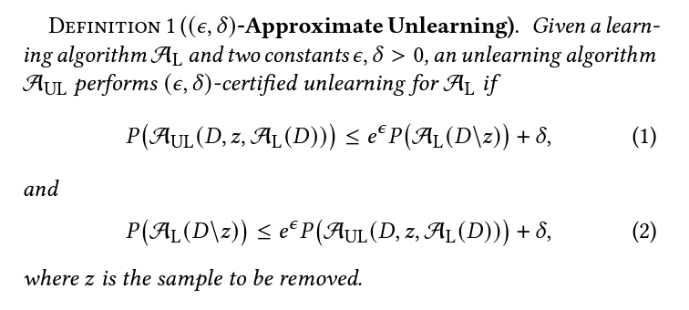
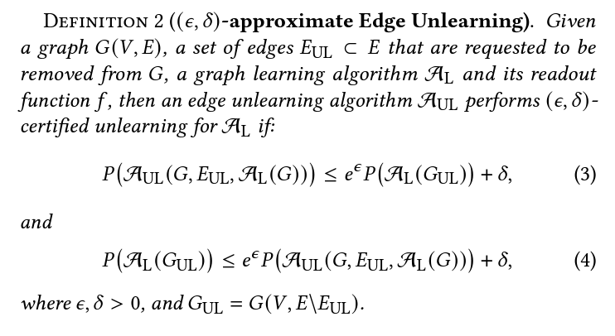
Certified Guarantee
P(AUL(D, z, AL(D))) represents the performance or probability of the unlearned model on the data D.
P(AL(D\z)) represents the performance or probability of the original model after removing z from the data D.
ϵ is a positive constant that controls how close the unlearned model should be to the original model. Smaller ϵ means they need to be very close.
δ is another positive constant, which adds some flexibility to the requirement. It allows for a little bit of difference between the models.
Definition 2 states that when we use the edge unlearning algorithm (AUL) to remove the specified edges E_{UL} from the graph G and then use the graph learning algorithm A_{L} to make predictions, the performance of this unlearned model A_{UL}(G, E_{UL}, A_{L}(G)) should be similar to the performance of the original model A_{L}(G_{UL}) where the edges in E_{UL} are removed. The difference between them should be within a certain range controlled by ϵ and δ.

Slide 15
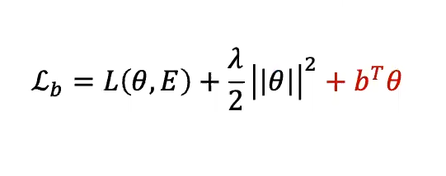
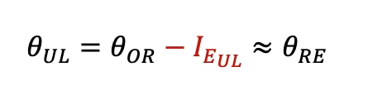

Methodology
Step 1: Adding Perturbation on Loss Function to hide the real gradient residual and provide the certified unlearning
guarantee
𝑏 is drawn randomly from the Gaussian distribution N(0, 𝜎2).
Step 2: Influence Analysis
𝜃_{UL} - Unlearned Model, 𝜃_{OR} - Original Model
𝜃_{RE} - Re-Trained Model, IE_{UL} - Closed form Update
Standard Influence function
It computes the parameters after the removal of 𝑧 by upweighting 𝑧 on the parameters with some small 𝜁
However, most of the existing influence functions cannot be directly applied to the GNN setting, as removing one edge e(vi,vj) from the graph can affect not only the prediction of vi and vj but also those of neighboring nodes of viand vj, due to the aggregation function of GNN models.

Slide 16
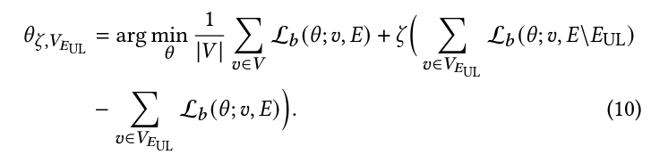

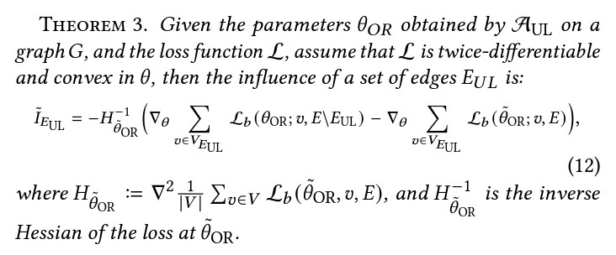
Methodology
To address this challenge, a new influence function for GNNs is introduced that take the neighborhood into consideration when estimating the influence of the neighborhood of removing an edge on model parameters.
Following the above reasoning, instead of solving the equation, the optimization problem as a closed-form update on the original model 𝜃˜_{OR} with the noisy loss function is formulated as follows:
𝐼_{EUL} is the influence of 𝐸_{UL} on the target model with noisy loss

Slide 17
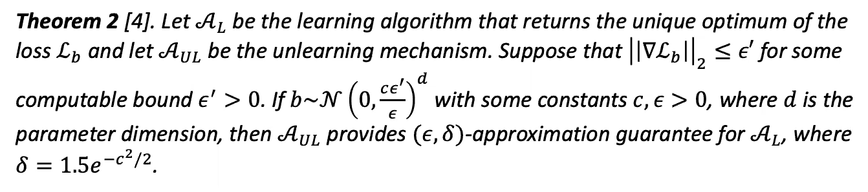
Methodology
Assumptions for the given GNN model and its loss function 𝐿:
𝐿 is a strictly convex loss function that is twice differentiable;
||∇𝐿||₂ ≤ 𝑐1;
∇2𝐿 is 𝛾1-Lipschitz;
∇𝐿 is 𝛾2-Lipschitz;
the node features 𝑥𝑣 is bounded: ||𝑥𝑣 ||₂ ≤ 1, ∀ 𝑣 ∈ 𝑉.
Here 𝑐1, 𝛾1, 𝛾2 are positive constants.
Although the theoretical analysis relies on the assumption of strictly convex loss function, our algorithmic techniques are generic and can be applied to various GNN models, including non-convex ones.
(𝜖, 𝛿)-approximation guarantee for AL
The theorem states that if the perturbation is performed according to the given distribution, then the A_{UL} mechanism provides a guarantee of (𝜖, 𝛿)-approximation for the A_{L} learning algorithm. 𝜖 represents the degree of approximation. 𝛿 is the confidence level associated with the approximation guarantee.

Slide 18

Experiment

Slide 19
Experiment Setup
Datasets: Cora, Citeseer, and CS
GNN Models:
Linear Models: SGC
Deep Models: GCN, GraphSAGE, and GIN
Edges for removal:
For Cora and Citeseer datasets: 𝑘 = {200, 400, 600, 800, 1,000}
For CS: 𝑘 = {2,000, 4,000, 6,000, 8,000, 10,000}

Slide 20
Experiment Setup
Metrics:
Model accuracy: The accuracy of node classification.
Unlearning efficiency: The running time of CEU.
Unlearning efficacy: The success rate of membership inference attack on GNNs. StealLink is used as the implementation of the membership inference attack.
Baselines:
Exact unlearning: BLPA and BEKM (GraphEraser)
Approximate unlearning: UEU (non-noisy CEU version) and CGU

Slide 21
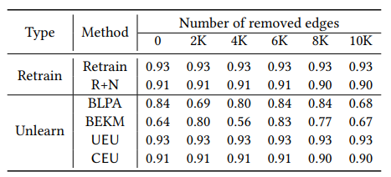
Model Accuracy
Model accuracy of CEU, Retraining (Retrain and R+N), and Baselines (BLPA, BEKM, UEU) for Linear GCN model, CS dataset
Main Observation:
CEU performs very close to the Retrained model regardless of the edges removed.

Slide 22
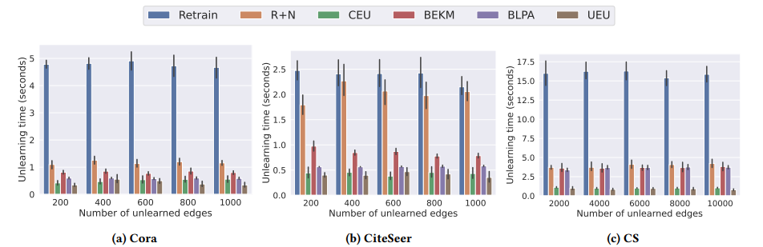
Unlearning Efficiency
Time performance of CEU, retraining (Retrain and R+N), and baselines (BLPA, BEKM, UEU) for linear GCN model.
Main Observation:
CEU is significantly faster than retraining from scratch.

Slide 23
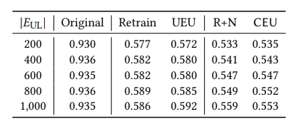
Unlearning Efficacy
Unlearning efficacy of CEU, retraining, and UEU for Linear GCN, Cora dataset.
Main Observations:
CEU has a similar ability to make the model forget the removed edges as retraining.
the AUC of both retraining and learning with noise (“R+N” and “CEU” columns) is lower than that without noise (“Retrain” and “UEU” columns)
Notes:
AUC close to 0.5 indicates that the model has removed the requested edges
. This demonstrates that the perturbation added to the loss function helps to reduce the privacy vulnerability of the removed edges.

Slide 24
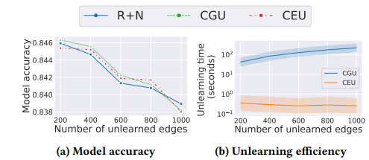
Comparison with CGU
CGU vs. CEU (SGC model, Cora dataset)
Main Observations:
The model accuracy of CEU stays close to CGU
CEU is much faster than CGU
Notes:
CEU is much faster than CGU with speed up by at least two orders of magnitude.

Slide 25
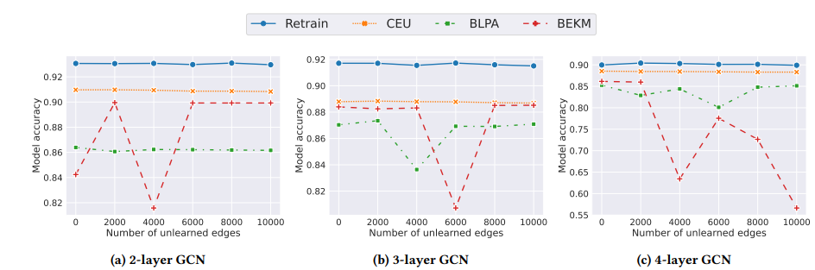
Model accuracy on complex GNNs
Model accuracy of CEU on deep GNN models (GCN, CS dataset).
Main Observation:
The model accuracy of CEU remains close to the retrained model and outperforms BLPA and BEKM.

Slide 26
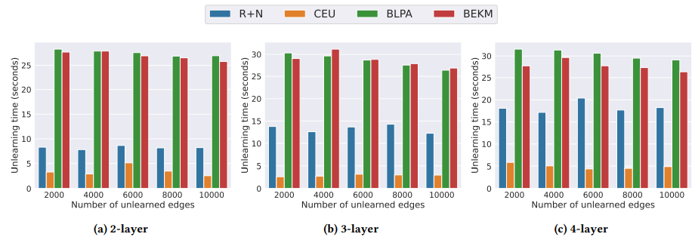
Unlearning efficiency on complex GNNs
Time performance of retraining and CEU on deep GNN models (GCN, CS dataset).
Main Observation:
CEU remains faster than the retraining model and the two baselines.

Slide 27
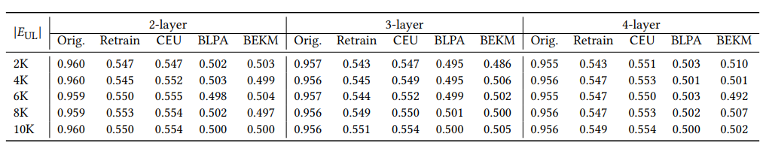
Unlearning efficacy on complex GNNs
Unlearning efficacy of CEU and baselines on deep GNN models (GCN, CS dataset).
Main Observation:
CEU exhibits a similar capability as either retraining or exact unlearning to make deep GNN models forget the removed edges

Slide 28
Conclusion
Efficiency: CEU is highly efficient in the unlearning process.
Theoretical Guarantee: CEU offers a robust theoretical guarantee, assuring the effectiveness of the unlearning procedure.
Performance: CEU consistently matches or surpasses retraining and the two baselines across all evaluation metrics.
Future Research Directions:
Node Unlearning: Exploring efficient and certified methods for removing nodes from graphs, considering the challenge of removing node features and labels.
Additional Constraints: Investigating the introduction of constraints on unlearning, such as defining an unlearning capacity to manage the maximum number of edges that can be deleted while maintaining model accuracy.

